Slide 1
Image Style Transfer
Speaker: Callin Dai, Yuran Jing, Haoxi Li, Tianyi Xu

Slide 2
Contents
04
Background & Motivation
Discussion
01
03
Method
Results
02

Slide 3
Background
&
Motivation
1

Slide 4
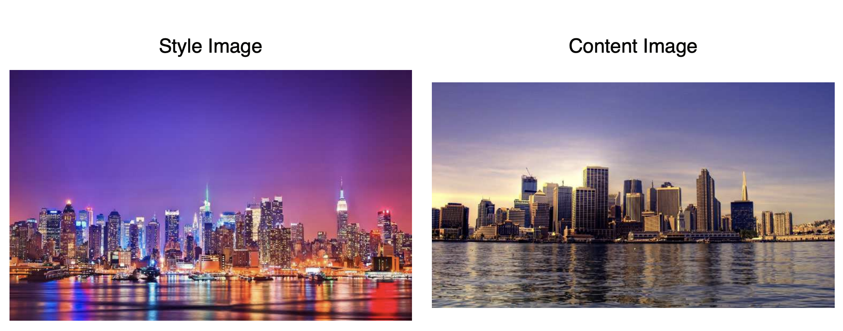
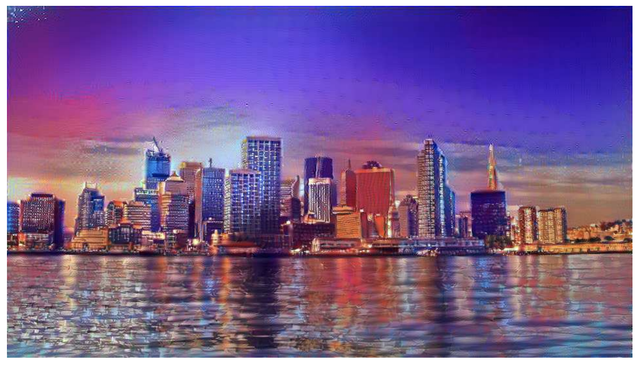
1.1 What is Style Transfer?
A class of software algorithms that manipulate digital images, or videos, in order to adopt the appearance or visual style of another image.
Techniques:
Singular CNN (Gatys et al.)
Generative Adversarial Networks
Diffusion Model
……

Slide 5
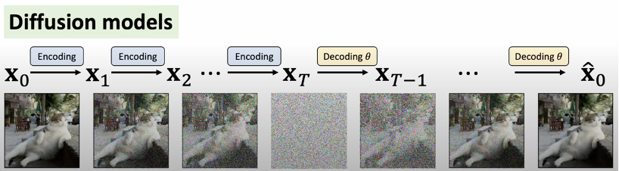
1.2 What is diffusion model?
Basic ideas:
Forward: Adding Gaussian noise.
Backward: Using U-Net to denoise => Recover the original image
CLIP
Text to Image Model

Slide 6
1.3 Why we fine-tune a stable diffusion model?
Previous (Cons):
Text to Image Model: Only can generate a specific style of image.
Neural Style Transfer & GANs: Deep layers, One model for one style.
Image to Image Model: Produce weird image contents.
Now (Pros):
Fine-tuned Stable Diffusion Model:
Text
Text
Style Transferred Image
Image
Image
More Flexible and Accurate

Slide 7
2
Methods

Slide 8
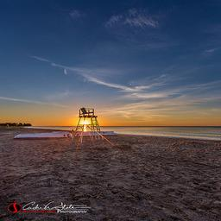
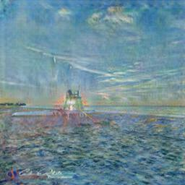
2.1 Dataset Creation
(a) Generate instructions
Input Prompt: "Make this image {style} style."
GPT-4
Instructions:
‘Mimic {style}'s style."
(b) Use CycleGAN/AdaIN paired images
CycleGAN/AdaIN
Notes:
We start with our dataset creation process. First, in order to finetune a text guided image-conditioned diffusion model, we need to have the text instruction that describes how we want to change our input image, specifically, the text description that describes transferring certain style of the input image. We use the state of the art GPT4 model to generate the instructions for us where we utilized the in-context learning ability, by providing it a few examples of our desired instructions, and the model would learned to output similar instructions from our input.
Then, we also need to have paired training examples consist of original images and stylized images. In this case, we utilized already existing style transfer models CycleGAN and Adaptive Instance Normalization, which is able to convert our input images into certain desired styles, for example, monet style in the example, which then will serve as training examples for our dataset.

Slide 9
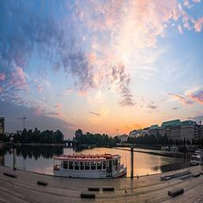
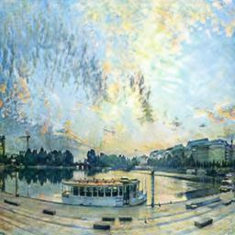
2.2 A Single Example from Dataset
Source Image
Instructions
Target
Portray the image in Monet style.
Notes:
By combining the text, and generated image, we created our dataset. Here is a single paired example from one of our dataset generated by cycle GAN and GPT4.

Slide 10
2.3 Model Fine Tuning
Stable Diffusion Model
Finetuned Model
Dataset
Finetune

Slide 11
2.3 Model Fine Tuning
Text Encoder/Tokenizer (Frozen)
Denoising U-Net
Finetuned Model
Dataset
VAE
Encoder
(Frozen)
QKV
QKV
VAE
Decoder
(Frozen)
Finetune
Notes:
Now we move into finetuning process. We finetune a image conditioned diffusion model, where our input is a image, and a text prompt, that serves as a condition in the denoising process, and the output is the image transferred based on the input image and our text instruction. We use one of our generated dataset. And while finetuning, we freeze the VAE image encoder and decoder as they only responsible for encoder/decode image into/from the latent space. Similarly, we freeze the text encoder/tokenizer. We only finetune the U-net which is responsible for generate/edit the image.

Slide 12
2.3 Model Fine Tuning
Text Encoder/Tokenizer (Frozen)
Denoising U-Net
Finetuned Model
Dataset
VAE
Encoder
(Frozen)
QKV
QKV
VAE
Decoder
(Frozen)
Finetune
Notes:
Now we move into finetuning process. We finetune a image conditioned diffusion model, where our input is a image, and a text prompt, that serves as a condition in the denoising process, and the output is the image transferred based on the input image and our text instruction. We use one of our generated dataset. And while finetuning, we freeze the VAE image encoder and decoder as they only responsible for encoder/decode image into/from the latent space. Similarly, we freeze the text encoder/tokenizer. We only finetune the U-net which is responsible for generate/edit the image.

Slide 13
2.41 Training Configuration
We used the following training configurations:
Resized Image to 256x256 resolutions.
random_flip
Batch size 2
Trained for 1000 epochs
learning_rate=5e-05 --lr_warmup_steps=0 --conditioning_dropout_prob=5e-2
Optimizer: Adam Optimizer

Slide 14
2.4 Experiment Setup
We finetuned models in 4 different configurations of models that is used to generate dataset and also their pretrained weights.
Model | Model Used to Generate Dataset | Number of Data | Pretrained Weight Used
GAN2800.SD | CycleGAN | 2800 | Stable Diffusion 1.5
GAN2800.IP2P | CycleGAN | 2800 | InstructPix2Pix
GAN8000 | CycleGAN | 8000 | InstructPix2Pix
ADAIN4946 | AdaIN | 4946 | InstructPix2Pix
Notes:
We finetuned models in 4 different configurations that differs in what model is used to generate our dataset, how many examples we generated, and also what pretrained sd weight is used. We start with a dataset generated by cycleGAN where we generated 2800 instance of it that uses SD1.5 weight. Later, we moved onto using IP2P, which is a SD finetuned for image editing task, as we believe it gives better result since it learned pixel-wise editing task and also serve as a baseline for comparing our models, so that’s how we get our second finetued model. We then also finetuned two more models using 8000 CycleGAN generated image and 4946 AdaIN generated image, both using IP2P pretrained weights.

Slide 15
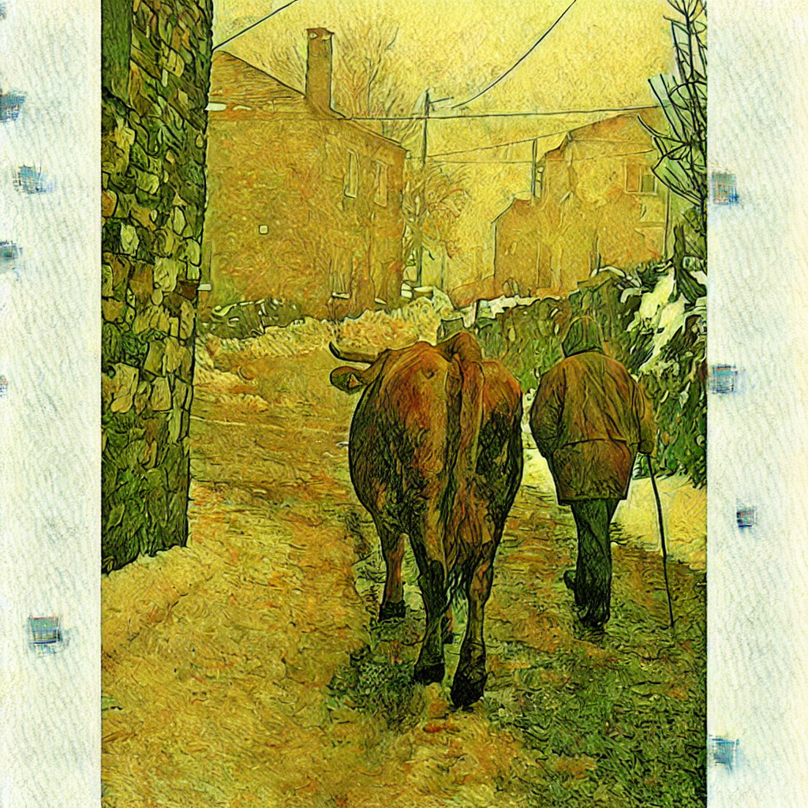
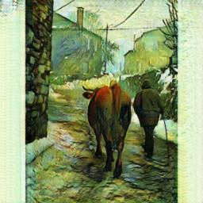
2.5 CLIP Similarity
Embedded Output Image
Clip Image Encoder
Cosine Similarity
Embedded Target Image
Notes:
We now move onto our evaluation methods. We first evaluate the CLIP similarity of our model, which is calculated by encoding the transferred image from our model, and also the testing set image from CycleGAN model into the CLIP latent space, and we compare the cosine similarity between the latent representation of our output image and the true transferred image. This measures how close our model’s output is to the image transferred of the style.

Slide 16
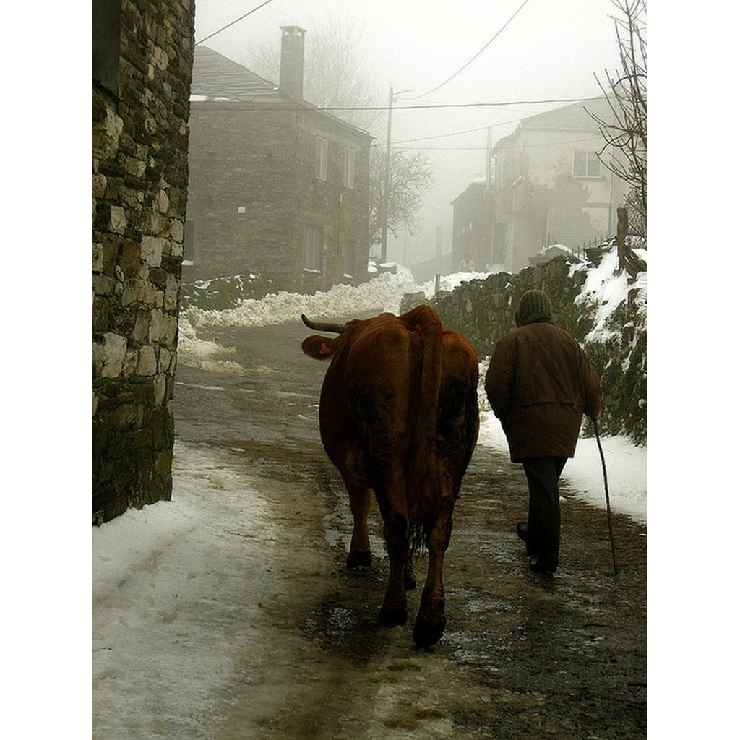
2.6 CLIP Directional Similarity
Embedded Original Image
Clip Image Encoder
Difference
Embedded Transferred Image
Cosine Similarity
Source Caption
Embedded Source Caption
Difference
Clip Text Encoder
Embedded Output Caption
Output Caption
Notes:
We also measure the CLIP directional similarity, which is calculated by encode the source image, and our model’s output image, into the CLIP latent space, and also the caption of the source and output image into the latent space. Where we compare the cosine similarity between the difference of the original image and transferred image, and the difference of original caption and caption of the transferred image. This is to measure the consistency of how much our image changed compared to the caption.

Slide 17
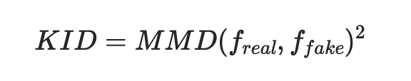
2.7 Kernel Inception Distance
Used to access the quality of generated image.
Measures the “Closeness” between real image and our generated image.
We compare artist drawing with our transferred image.
Notes:
Lastly, we also want to see how real is our generated image. Usually this is done by calculating the Frechet Inception Distance. But we do not have enough generated images and target images to calculate it, instead, we look at the Kernel Inception Distance, or KID. This measures how close a subset of our image is to the subset of the actual real images from the artists is by taking the square of the maximum mean discrepancy of the image features.

Slide 18
3
Results

Slide 19
3.1 Quantitative Result Summary
Model | Average Clip Similarity | Average Clip Directional Similarity | Kernel Inception Distance (KID)
InstructPix2Pix | 0.813 | 0.105 | 0.0421
GAN2800.SD | 0.846 | 0.112 | 0.0300
GAN2800.IP2P | 0.857 | 0.1137 | 0.0335
GAN8000 | 0.869 | 0.1144 | 0.0241
ADAIN4946 | 0.811 | 0.099 | 0.0315
Notes:
From the table, we can tell GAN8000 is performing the best across all evaluation criteria.
Higher average CLIP similarity means a closer match in content and style to the reference. Higher CLIP directional similarity means a more consistent directional change from source to generated content.
KID: How we do the KIDS is we compare our generated images with the artists’ work, and the lower the score is the higher fidelity the images contain. ( in the other words, more like artists’ real work)

Slide 20
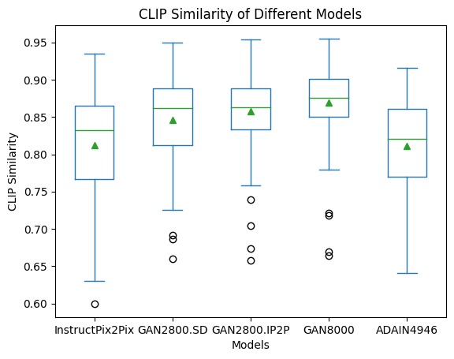
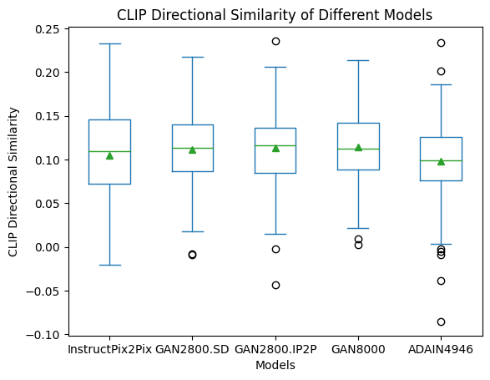
3.2 Results
Notes:
Here we have two result graph.
InstructPix2Pix (InP2P) has the largest similarity variance among all, suggesting that this model is very unstable in transferring styles. In other words, it is inconsistent in transferring styles or maintaining similarity across tasks.
GAN8000 is demonstrating not a notly only an overall best performance in transferring styles, but also more stable performance compared to other models.
CLIP Directional Similarity:
All models demonstrate a comparable level of performance on average, which indicates a similar ability to retain information from the source image in the generated ones.
However, as can be observed, InstructPix2Pix still exhibits the largest variance, suggesting that the amount of change in features is the most variable among the models.
This indicates that InstructPix2Pix can produce results that diverge significantly from the source, leading to greater unpredictability in its output. This characteristic might make it less reliable for applications requiring consistency.

Slide 21
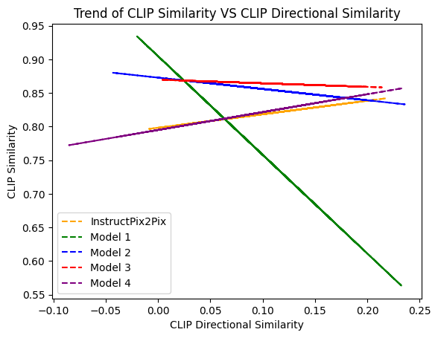
3.1 Results

Slide 22
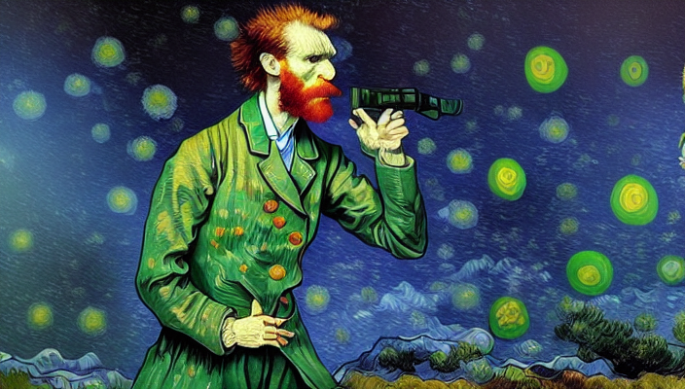
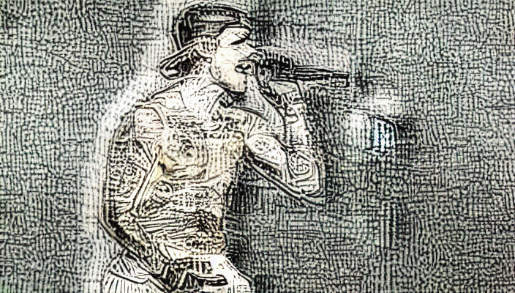
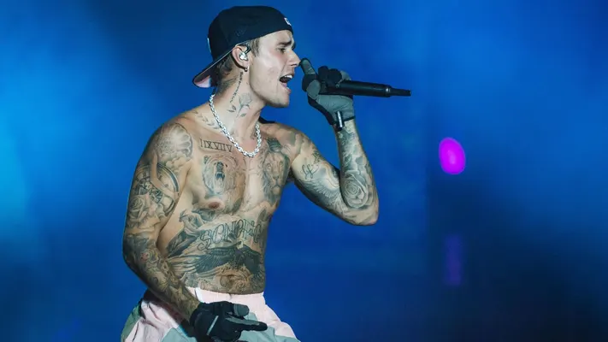
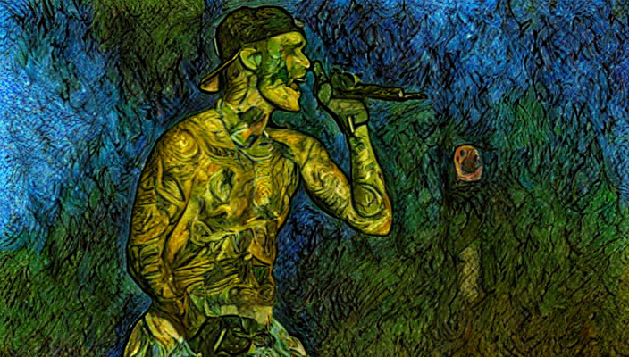
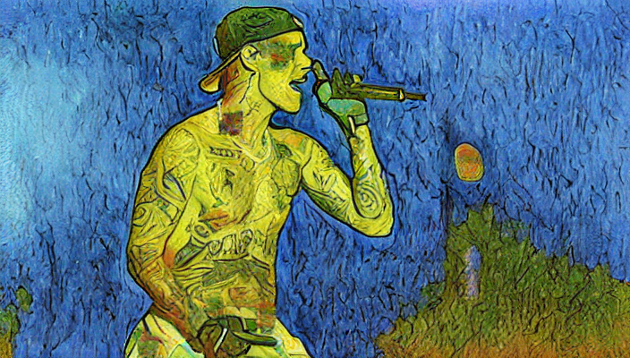
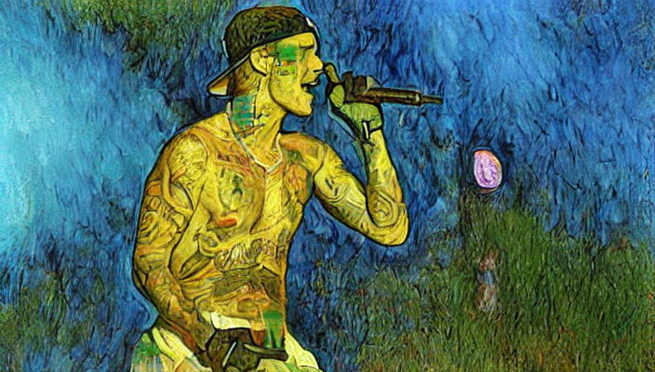
3.3 Output
Instruct Pix2pix
ADAIN4946
GAN2800.SD
GAN2800.IP2P
Add Van Gogh Style to this image
GAN8000
Notes:
From this example, we can observe the differences between different models. For instruct pix2xpix, as mentioned previous. It is showing the largest variance. In both CLIP similarities and directional similarities. Here, when instruct to transfer into Van Gogh style, Justin bieber is transformed into Vangoh, which significantly deviates from the original content.
GAN8000, obviously.

Slide 23
Instruct Pix2pix
ADAIN4946
Add Van Gogh Style to this image
GAN2800.SD
GAN2800.IP2P
GAN8000
Notes:
From this example, we can observe the differences between different models. For instruct pix2xpix, as mentioned previous. It is showing the largest variance. In both CLIP similarities and directional similarities. Here, when instruct to transfer into Van Gogh style, Justin bieber is transformed into Vangoh, which significantly deviates from the original content.
GAN8000, obviously.

Slide 24
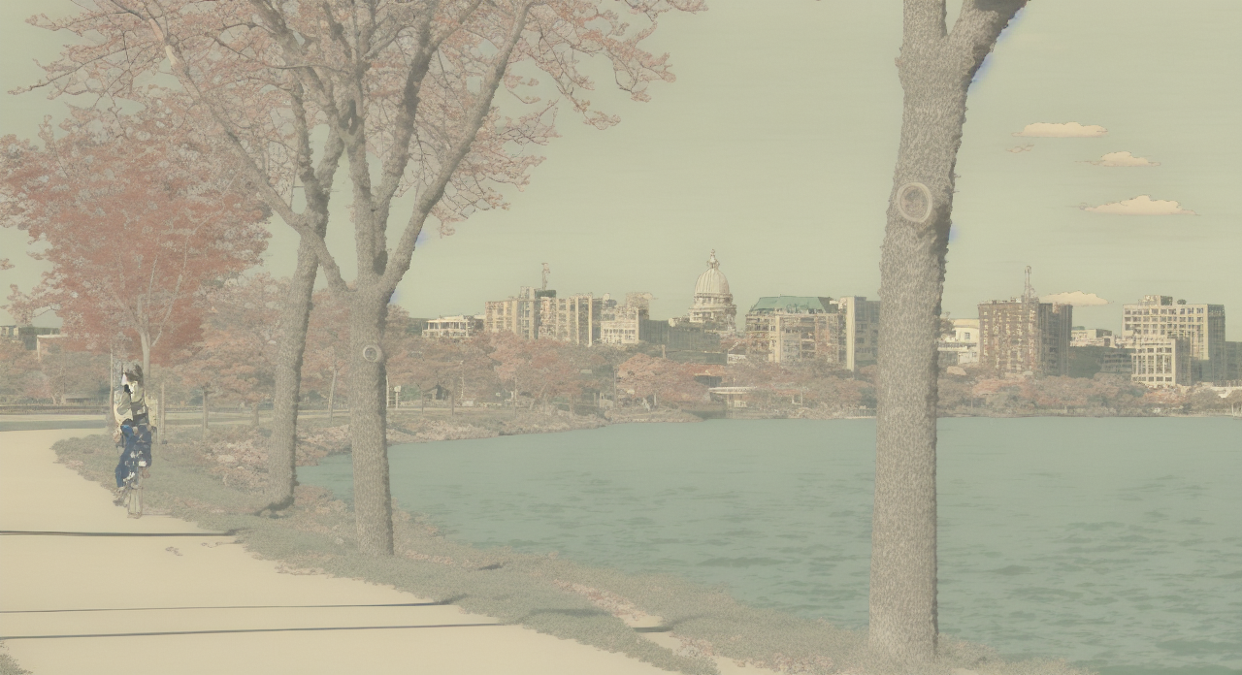
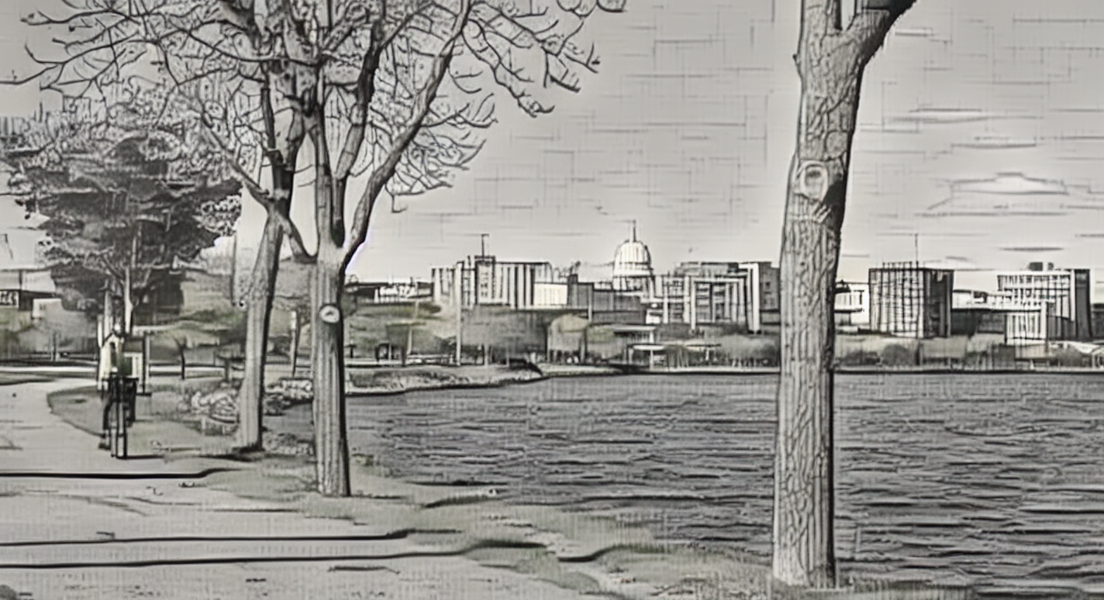
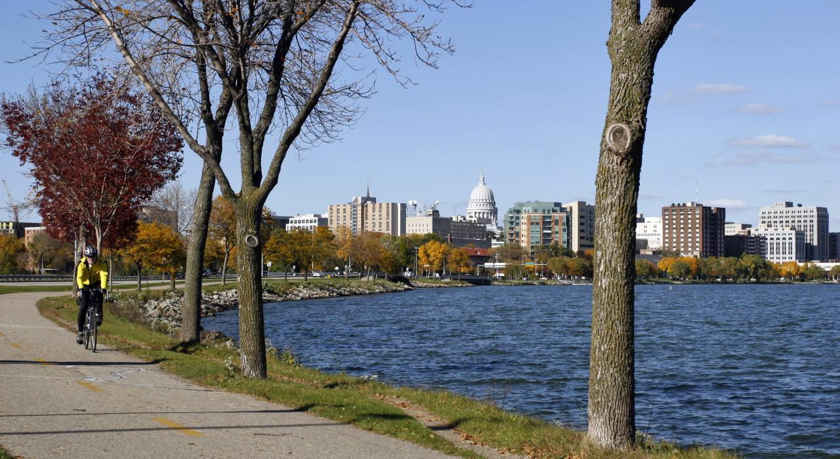
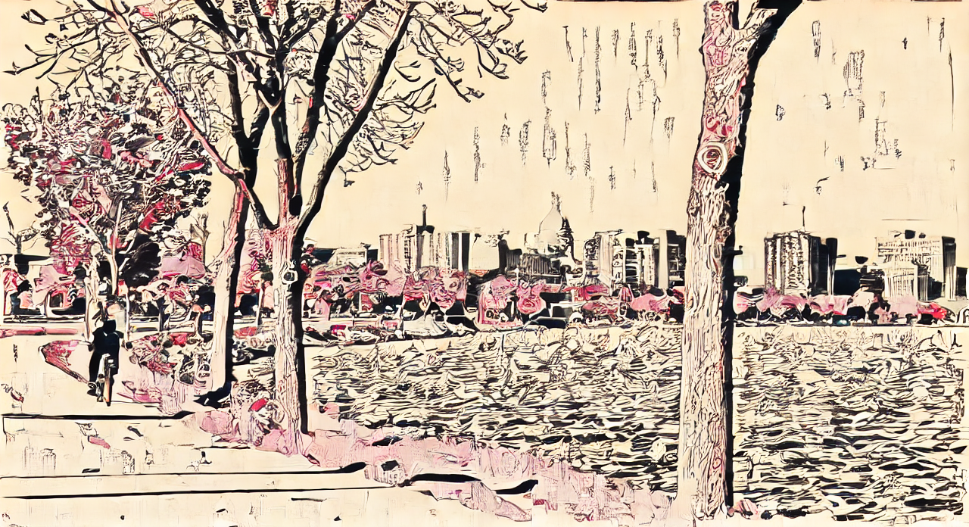
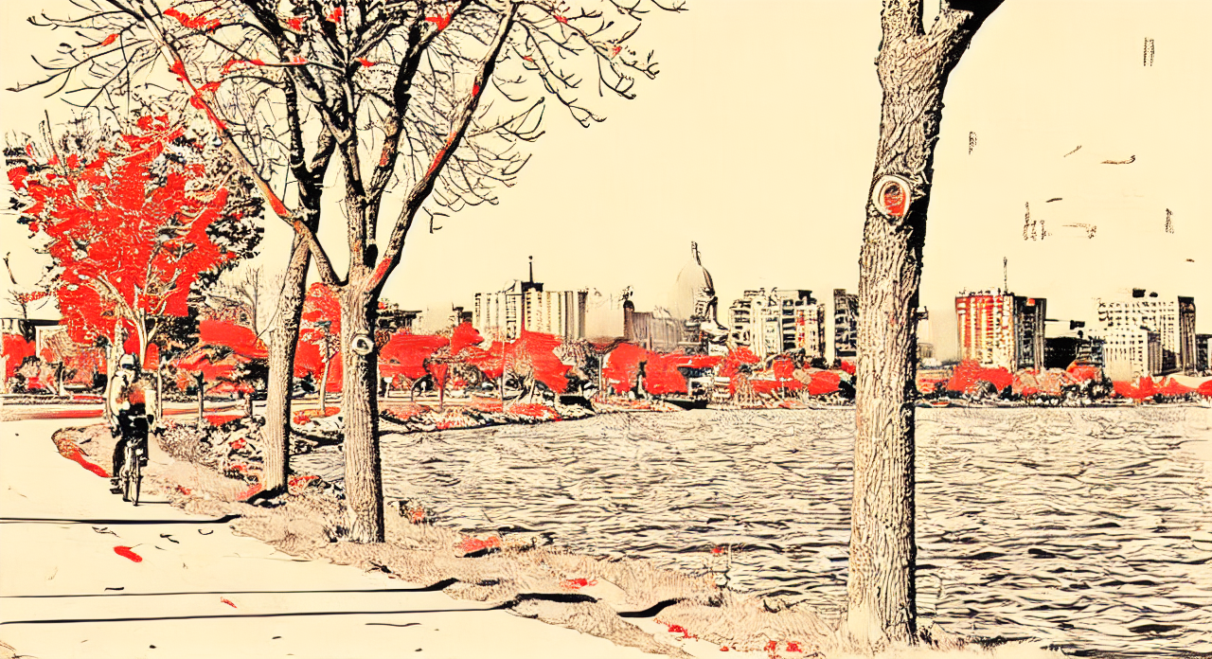
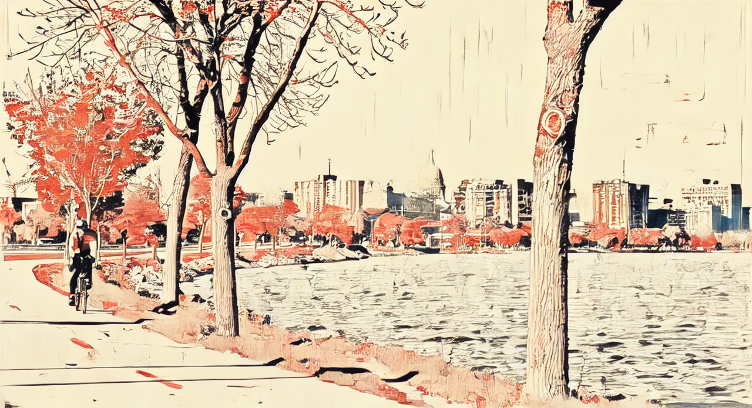
3.3 Output
Instruct Pix2pix
ADAIN4946
GAN2800.SD
GAN2800.IP2P
Add Ukiyoe Style to this image
GAN8000
Notes:
Here is another example, . For instruct pix2xpix, compared to the previous example , did not change much from the original content.indicating its large variance in CLIP directional simialritie.

Slide 25
Instruct Pix2pix
ADAIN4946
Add Ukiyoe Style to this image
GAN2800.SD
GAN2800.IP2P
GAN8000
Notes:
Here is another example, . For instruct pix2xpix, compared to the previous example , did not change much from the original content.indicating its large variance in CLIP directional simialritie.

Slide 26
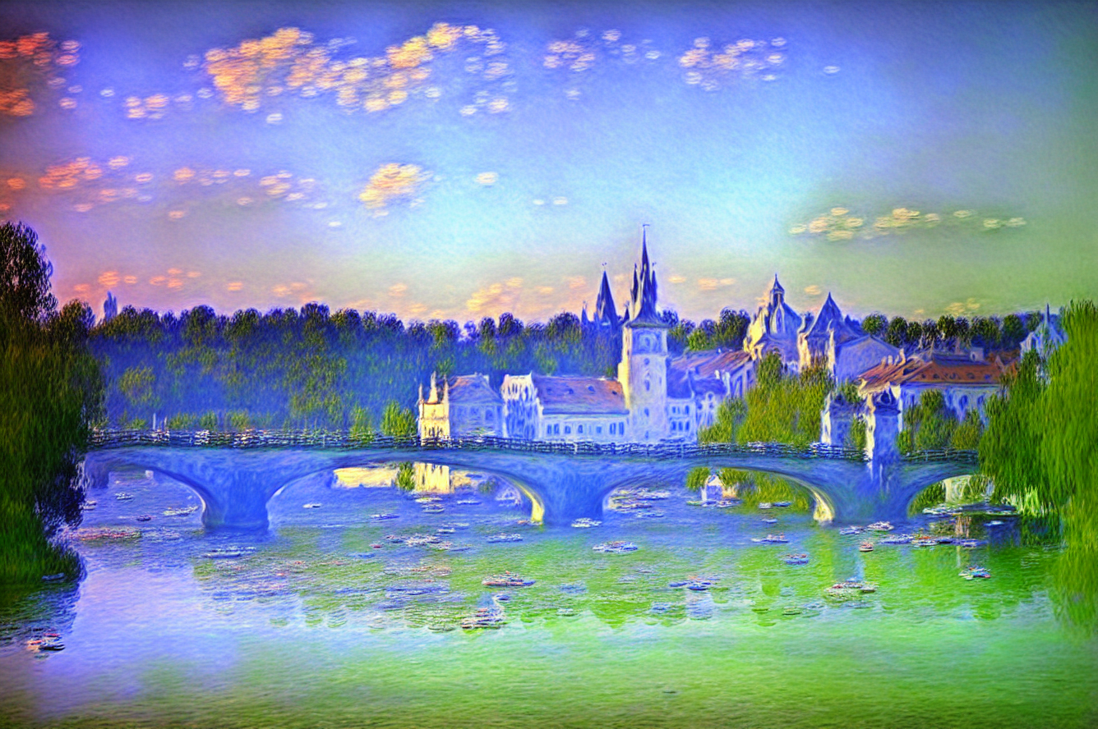
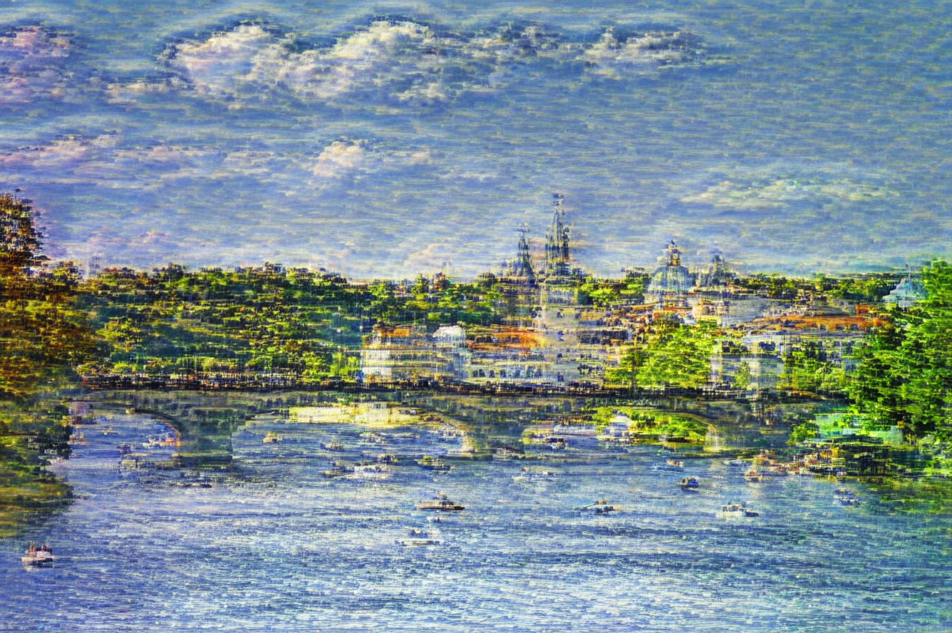
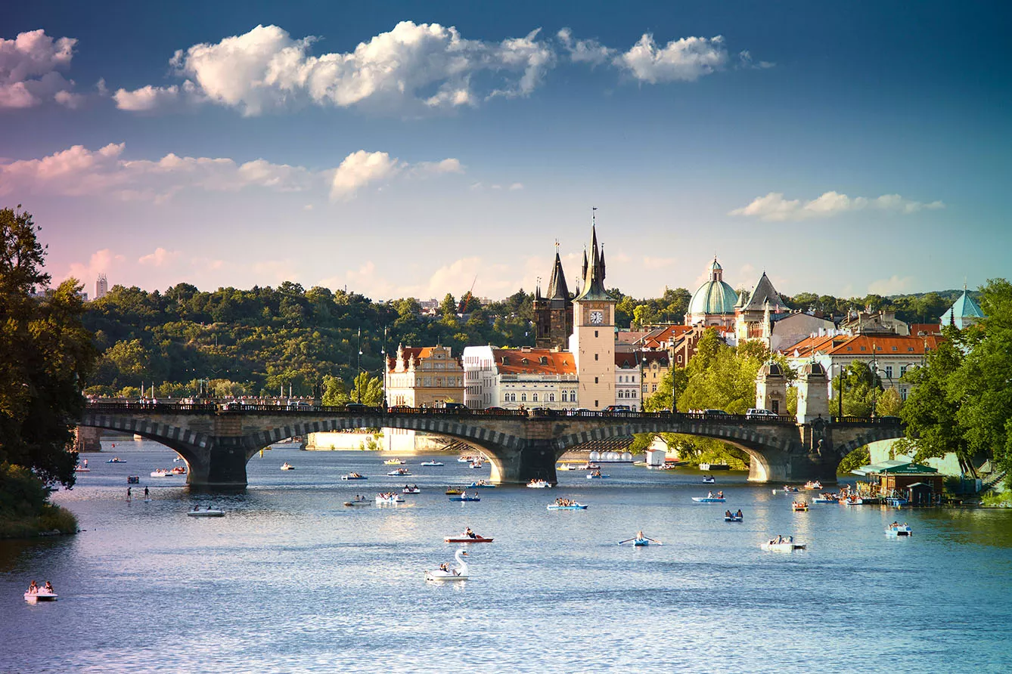
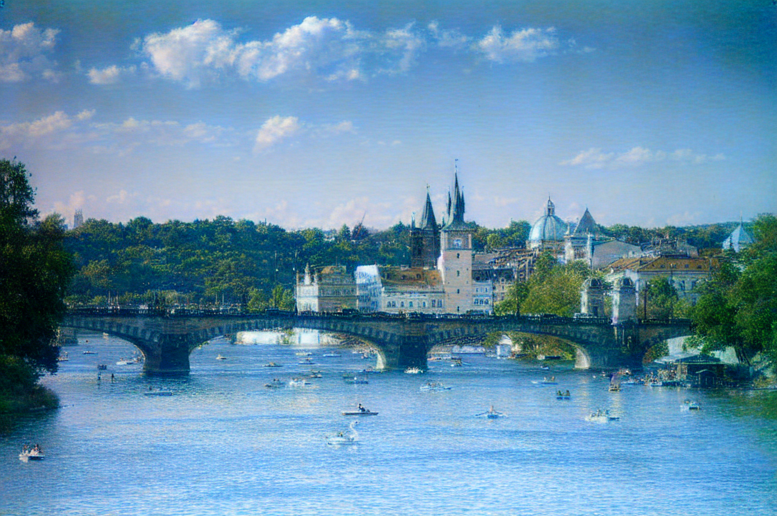
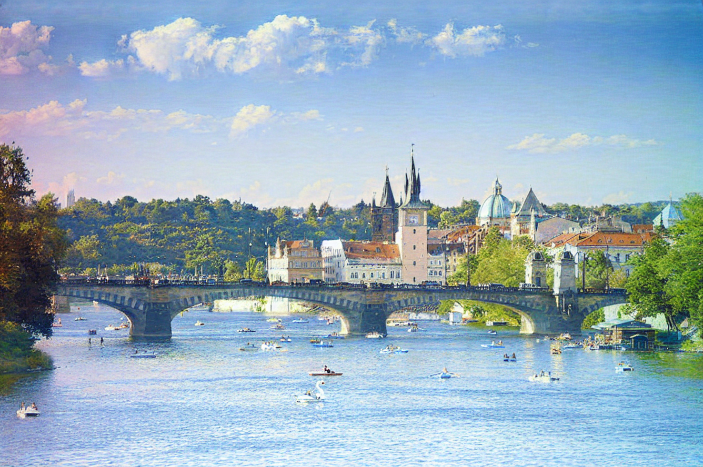
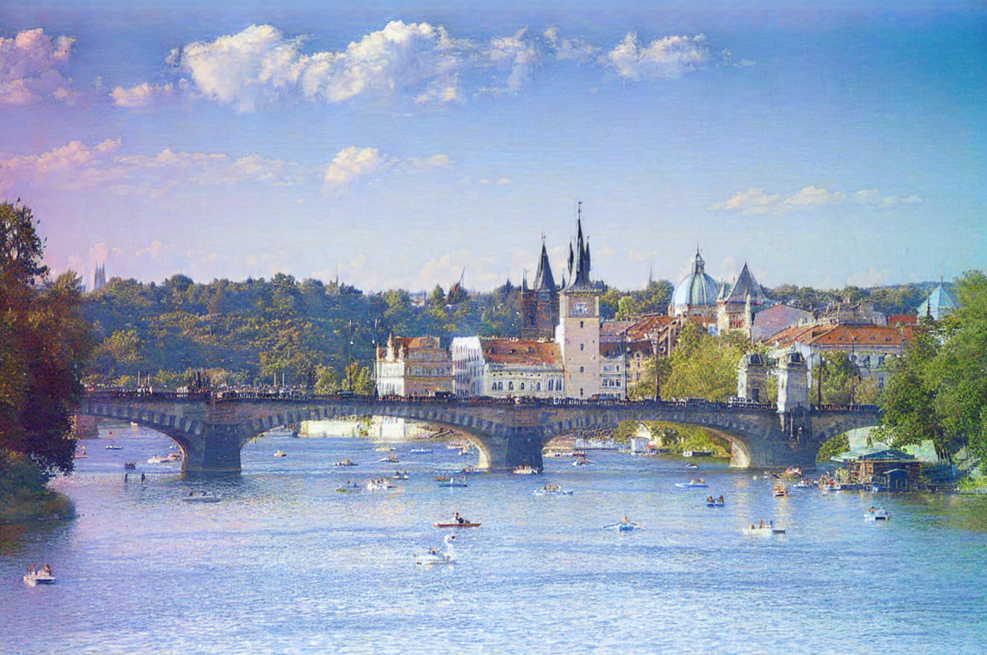
3.3 Output
Instruct Pix2pix
ADAIN4946
GAN2800.SD
GAN2800.IP2P
Add Monet Style to this image
GAN8000

Slide 27
Instruct Pix2pix
ADAIN4946
Add Monet Style to this image
GAN2800.SD
GAN2800.IP2P
GAN8000

Slide 28
4
Discussion

Slide 29
4.1 Conclusion
Fine-tuned stable diffusion model for style transferring tasks
Generated paired training dataset
Model performed well on small dataset
Achieved transferring multiple style using a single model.

Slide 30
4.2 Limitation
Cannot transfer style not in dataset very well
Slow inference and fine-tuning process

Slide 31
4.3 Future Steps
Explore different dataset generation model and training configuration
Use different model architectures
Denoising Diffusion Probabilistic Model(DDPM)
Denoising Diffusion Implicit Model(DDIM)

Slide 32
Thank you!

Slide 33
4.2 Limitation
Cannot transfer style not in dataset very well
Slow inference and fine-tuning process

Slide 34
4.1 Conclusion
Fine-tuned stable diffusion model for style transferring tasks
Generated paired training dataset
Model performed well on small dataset
Achieved transferring multiple style using a single model.

Slide 35
Conclusion and Limitation
Tried finetuning stable diffusion model for style transferring tasks.
Generated dataset using CycleGAN and AdaIN (https://arxiv.org/abs/1703.06868)
Achieved transferring multiple style using a single model.
Model performed well on generated dataset by just finetuning on small scale dataset.
Limitation - Still cannot transfer style not in dataset.
Slow at image generation.
Slow to train.

Slide 36
Future Steps
Add more style to the dataset.
Explore different training configuration./larger dataset
Explore different dataset generation model.
Explore different model architecture. ddpm(higher quality)&ddim(faster)
Explore more/Improve evaluation methods (especially KID/FID)(dataset)

